Slide 1
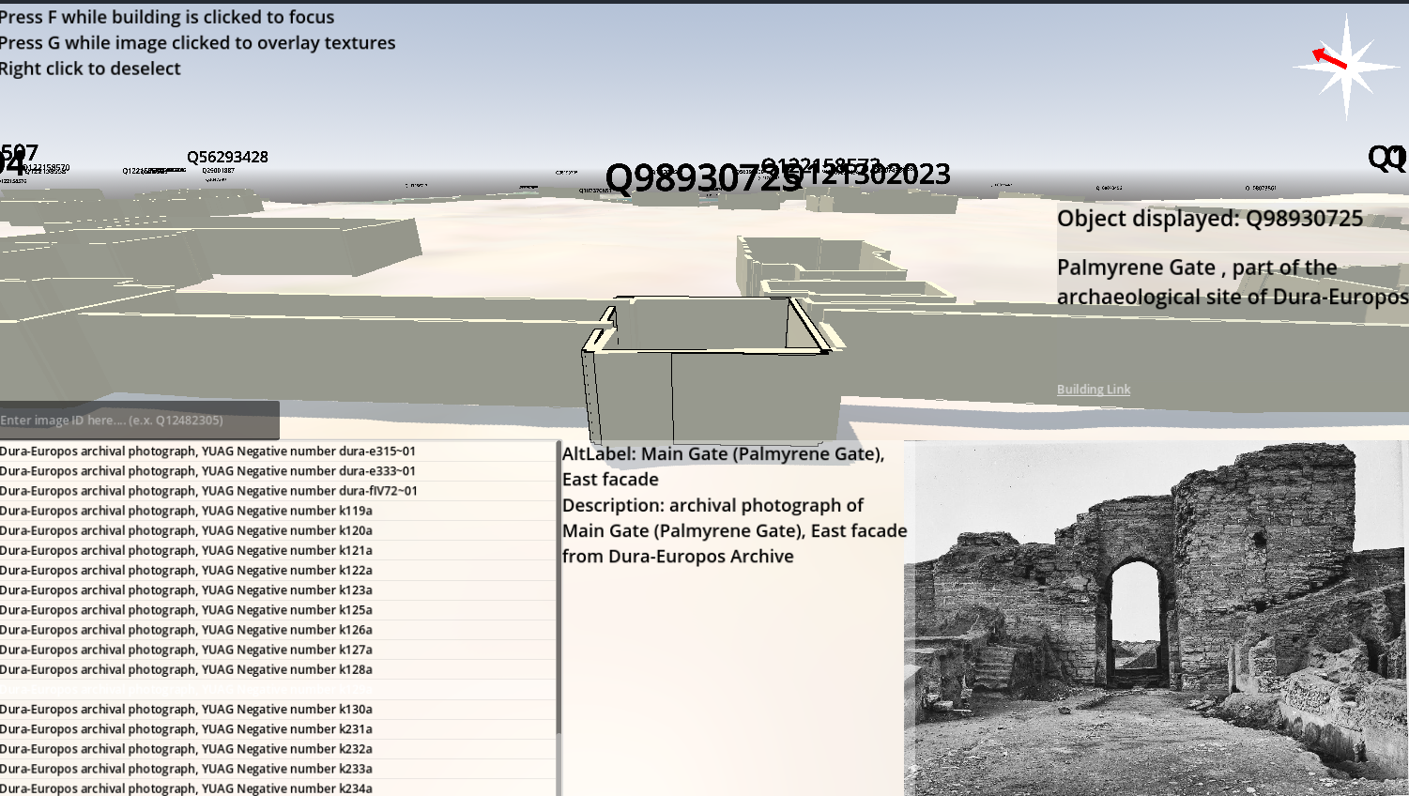
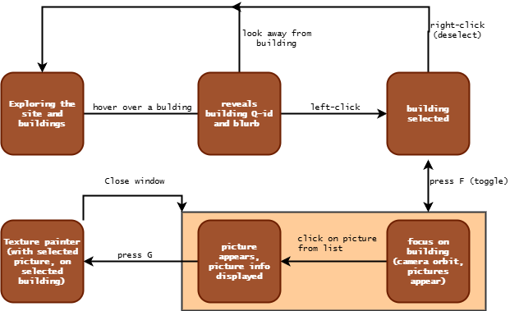
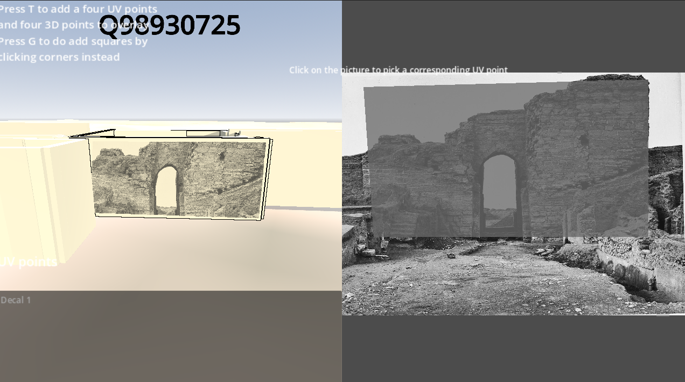
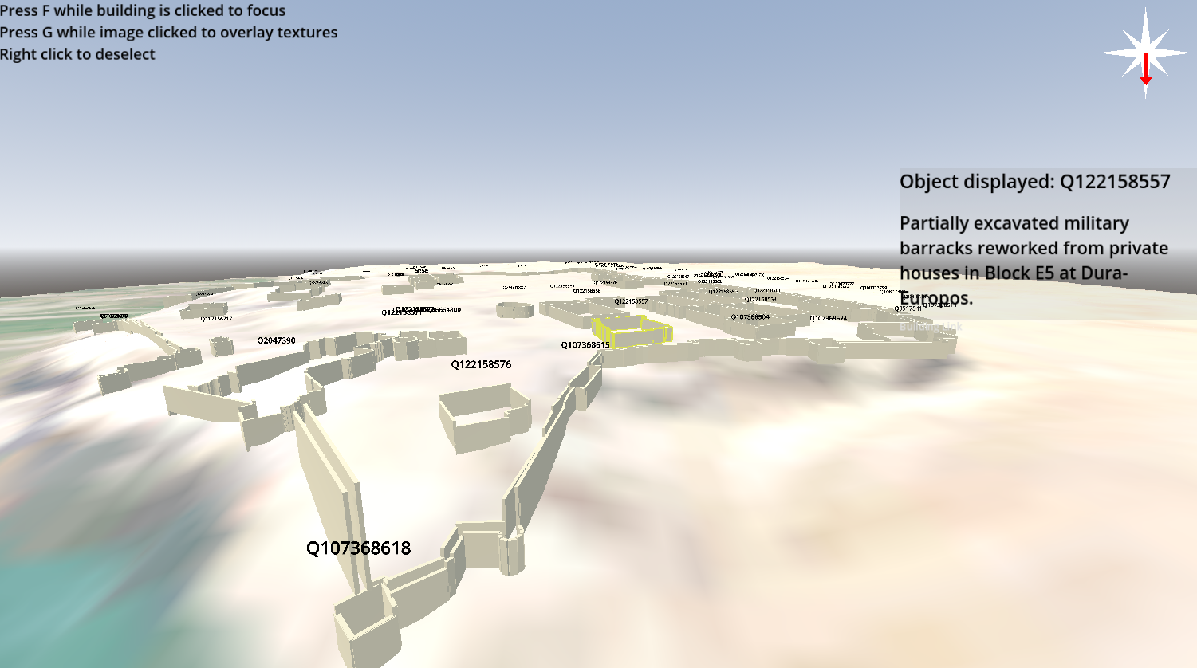
GAMIFYING ARCHEOLOGY: An interactive 3D representation of Dura-Europos
Ali Hafez, Computer Science, Yale University Class of 2025
Mike Shah, Senior Lecturer of Computer Science, Yale University
Holly Rushmeier, John C. Malone Professor of Computer Science, Yale University
Made with Godot 4.4
INTRODUCTION
MY PROJECT
BUILDING “FOCUS” AND PHOTOS
Dura-Europos was a bustling Hellenistic, Parthenian, and Roman city in the ancient Fertile Crescent, established along the banks of the Euphrates. The historical site has been a significant target of archeological research and interest ever since its excavations in the 19th and 20th centuries. The interest arises because of its uniquely well-preserved state, its diversity -- the city contained a Christian church, a Jewish synagogue, and many other temples -- and its multitude of artifacts.
New technology seeks to allow archeologists to mitigate the worldwide dispersal of these artifacts, distance from the site, and degradation/destruction of the site in the hundred years of exposure and instability since. Namely, the International (Digital) Dura-Europos Archive, an initiative co-directed by my advisor, Holly Rushmeier. The hope of this archive is -- in their words – to "reassemble and re-contextualize archaeological information related to Dura-Europos. This mission is also exemplified by my project, which takes reassemble literally -- in the case of a 3D reconstruction of the site.
My project can be summarized as an interpretation of the information in the Dura-Europos dataset, that takes various media and places them realistically in a 3D world, specifically in Godot Engine. Using just the digital archive, the software should be able to completely display as many aspects of the site as possible, in as much detail as necessary, and eventually enable editing and addition of new information.
The reason why the project is called “gamifying” is because the hope is that, eventually, the application could allow laypersons to participate in the linking and investigation of these archeological photos and artifacts. Like popular “citizen science” projects, this “gamification” could encourage anyone interested to involve themselves in the project.
“GAMEPLAY” LOOP
TEXTURE PAINTING
INTENDED FEATURES (GOALS)
> Represent the terrain under the site
> Construct 3D models of buildings from geoJSON data and accurately place them on the site (Haversine formula)
> Allow these structures to be clicked and ”focused” on
> Use SPARQL to request data from the dataset about structures and a list of photographs depicting them
> Create an interface allowing users to click and display photos
> Allow the user to select points on a photo and 3D points on a building mesh and “paint” the texture on the building’s wall
> Give the user the ability to save and export this new, “painted” model of the building as a 3D file
SITE VISUALIZATION
CONCLUSIONS & FUTURE WORK
The project’s goals were achieved successfully, and they function well apart from some simple bugs that are in the process of being fixed. In addition, the project was able to be used by a researcher on the project, who provided feedback and some suggestions for future features. In the short term, features like custom building and mesh queries will be added.
Due to excitement about the project among the IDEA research group, Prof. Rushmeier is looking for students to resume work over the summer before another student continues in the fall. This means I will be creating documentation and an easy path to future development and expansion of functionality of the software.

